Slide 1
Infectious Diseases
Ebola

Slide 2
Ebola- Origins
Ebola virus was first discovered in 1976 near the Ebola River in what is now the Democratic Republic of Congo.
Since then, the virus has been infecting people from time to time, leading to outbreaks in several African countries.

Slide 3
An interesting aspect of Ebola is that it was only discovered in 1976. It seems unlikely that cases or outbreaks never occurred before. A narrative from 1865 by explorer Samuel Baker from the south of Sudan, close to where the 1976 outbreak occurred, offers some insight. While Baker calls the disease “the plague”, it is evident that the symptoms describe a lethal form of haemorrhagic fever, perhaps Ebola, as the following excerpt narrates:
“For some days two or three of our men had been complaining of severe headache, giddiness, and violent pains in the spine and between the shoulders. One of the boatmen, who had been ailing for some days, suddenly went to the side of the vessel and hung his head over the river; his nose was bleeding!
Another of my men, Yaseen, was ill; his uncle, came to me with a report that "his nose was bleeding violently!’ Several other men fell ill; they lay helplessly about the deck in low muttering delirium, their eyes as yellow as orange-peel. In two or three days the vessel was so horribly offensive as to be unbearable. The plague has broken out! Yaseen died. We stopped to bury him. The funeral hastily arranged, we again set sail. Mahommed died; he had bled at the nose. Another burial. Once more we set sail and hurried down the Nile. Several men were ill, but the dreaded nose bleed had not appeared.
One morning the boy Saat came to me with his head bound up, and complained of severe pain in the back and limbs. In the afternoon I saw him leaning over the ship's side; his nose was bleeding violently! At night he was delirious. On the following morning he was raving, he threw himself into the river to cool the burning fever that consumed him. His eyes were suffused with blood, which, blended with a yellow as deep as the yolk of egg, gave a terrible appearance to his face. The faithful boy that we had adopted, was now a victim to this horrible disease. He was a fine strong lad of nearly fifteen, and he now lay helplessly on his mat, and cast wistful glances at the face of his mistress as she gave him a cup of cold water mixed with a few. An hour passed, and he slept. Karka, the slave woman, quietly went to his side; gently taking him by the ankles and knees, she stretched his legs into a straight position, and laid his arms parallel with his sides. She then covered his face with a cloth. ‘Does he sleep still?’ I asked. The tears ran down the cheeks of Karka as she sobbed, ‘He is dead’.”

Slide 4
Ebola- Different Strains
Ebola virus (species Zaire ebolavirus)
Sudan virus (species Sudan ebolavirus)
Taï Forest virus (species Taï Forest ebolavirus)
Bundibugyo virus (species Bundibugyo ebolavirus)
Reston virus (species Reston ebolavirus)
Bombali virus (species Bombali ebolavirus)

Slide 5
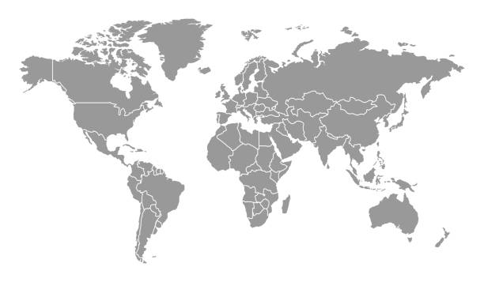
Reston Ebolavirus
Bombali Ebolavirus
Tai Forest Ebolavirus
Bundibugyo Ebolavirus
Sudan Ebolavirus
Zaire Ebolavirus

Slide 6
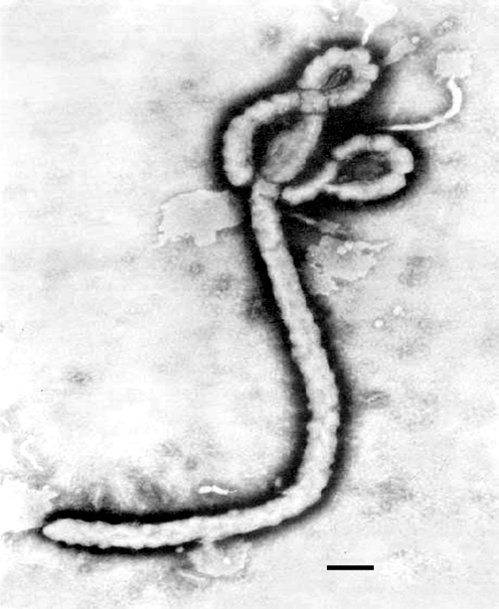

Slide 7
Ebola- Zoonotic Spillover
Scientists do not know where Ebola virus comes from.
Based on similar viruses, they believe Ebola is zoonotic, with bats or non-human primates being the most likely source.
Infected animals carrying the virus can transmit it to other animals, like apes, monkeys, antelope and humans.

Slide 8
Ebola- Risk Factors
Blood or body fluids (urine, saliva, sweat, faeces, vomit, breast milk, amniotic fluid, and semen) of a person who is sick with or has died from Ebola.
Objects (e.g. clothes, bedding, needles, and medical equipment) contaminated with body fluids from a person with Ebola.
Infected fruit bats or primates (e.g. apes and monkeys).
Semen from a man who recovered from Ebola (no evidence that Ebola can be spread through sex or other contact with vaginal fluids from a woman who has had it).

Slide 9
Ebola- Locations
Whilst the majority of cases are located throughout Africa, Ebola cases have been confirmed in Italy, Mali, Nigeria, Senegal, Philippines, Spain, the United Kingdom, and the United States.

Slide 10
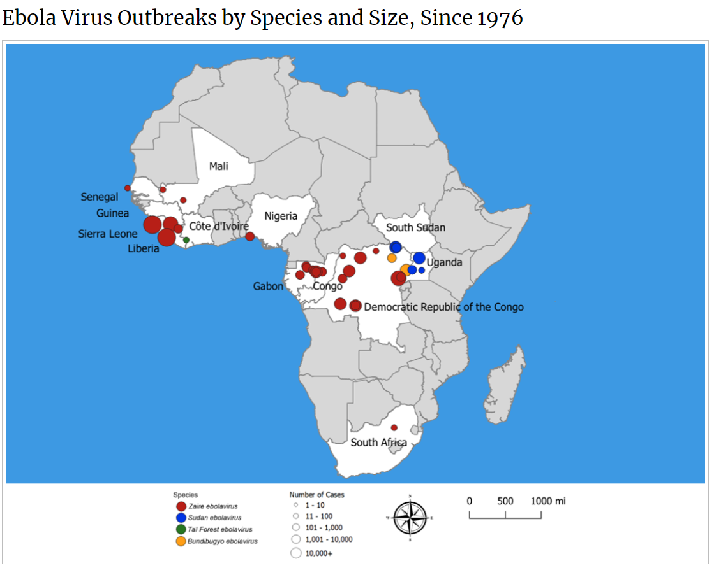

Slide 11
Ebola- Signs and Symptoms
The incubation period (the time interval from infection with the virus to onset of symptoms) is from 2 to 21 days. A person infected with Ebola cannot spread the disease until they develop symptoms. Symptoms of Ebola include:
Fever
Fatigue and muscle pain
Headache and sore throat
This is followed by:
Vomiting and diarrhoea
Rash
Symptoms of impaired kidney and liver function
Both internal and external bleeding (not in all cases)

Slide 12
Ebola- Spread through the body
Once the virus enters the body, it targets several types of immune cells. With defective immune cells, other cells and antibodies don't respond to infection. The virus can start replicating immediately and very quickly.
As Ebola travels in the blood throughout the body, other immune cells are infected. They release proteins that trigger coagulation, forming small clots throughout the blood vessels and reducing blood supply to organs. They also produce other inflammatory signalling proteins and nitric oxide, which damage the lining of blood vessels, causing them to leak (bleeding from eyes and nose).

Slide 13
Ebola- Spread through the body
Ebola triggers a system-wide inflammation and fever damaging many types of tissues in the body. But the consequences are especially profound in the liver, where Ebola wipes out cells required to produce coagulation proteins and other important components of plasma (leading to diarrhoea).
In the adrenal gland, the virus cripples the cells that make steroids to regulate blood pressure and causes circulatory failure that can starve organs of oxygen.
Damage to blood vessels leads to a drop in blood pressure, and patients die from shock and multiple organ failure.

Slide 14
Ebola- Diagnosis
If a person shows signs of Ebola, they should be isolated and public health authorities notified. Blood samples from the patient should be collected and tested to confirm infection. Ebola can be detected in blood after onset of symptoms. It may take up to three days after symptoms start for the virus to reach detectable levels.
Polymerase chain reaction (PCR) is one of the most commonly used diagnostic methods because of its ability to detect low levels of Ebola virus.
The issue is access to health care facilities to diagnose Ebola before it spreads through villages and communities.

Slide 15
Ebola- Treatment and Cost
Treatment has been in the research levels from 1997-2020.
Currently two treatments approved to treat Ebola Zaire. The first was approved in October 2020, Inmazeb, with the second, Ebanga approved in December 2020. Both are combinations of antibodies designed to stop the virus from replicating once inside the body.
Both of these treatments, along with two others, were evaluated in a randomised controlled trial during the 2018-2020 Ebola outbreak in the Congo.
Neither Inmazeb nor Ebanga have been evaluated for efficacy against species other than Zaire.

Slide 16
Ebola- Treatment and Cost
Regeneron expects to deliver an established number of treatment doses over the course of 6-years and receive compensation of approximately $10 million in 2021 and an average of $67 million per year for each of the next five years (2022-2026).
225, 000 people had been vaccinated by March of 2021. This approximately works out to be $44 a vaccine. At the moment, this is being covered by World Government Donations.

Slide 17
Ebola- Fatality
Ebola species | Fatality Rate
Zaire ebolavirus | 60-90%
Sudan ebolavirus | 40-60%
Taï Forest ebolavirus | 50-90%
Bundibugyo ebolavirus | 25%
Reston ebolavirus | 0% (has infected humans)
Bombali ebolavirus | 0% (has not infected humans)

Slide 18
Ebola- 1976
Three-quarters of Zaire’s population lived in forest villages in 1976. Estimates suggest that each of the forest villages had a population of less than 5,000 people; the smallest villages had less than 500 inhabitants. Many of these villages bordered the Zaire River.
Most of Zaire’s people either hunted or had contact with hunters that were exposed to an array of wild animals.

Slide 19
Ebola- 1976
Mabalo Lokela, the principal of a school, was the first case. Initially, Lokela was diagnosed with malaria at the Mission Hospital.
Lokela returned to the hospital on September 1st with a high fever. Rest was recommended, and he returned home to his village, about 1 kilometre away.
By the 5th of September, Lokela was worse with profuse bleeding, vomiting, diarrhoea, chest pains, headache, fever, agitation, and confusion. He died on the 8th of September.

Slide 20
Ebola- 1976
In August, a number of other cases were presented at the Mission Hospital.
A report from the World Health Organization noted that "almost all subsequent infections had either received injections at the hospital or had had close contact with another case."
Shortly after family members prepared his body for burial, in accordance with local customs, 21 of Lokela's friends and relatives fell seriously ill and 18 later died.

Slide 21
Ebola- 1976
The Mission Hospital was a remote Catholic hospital operated by nuns and had no trained doctors or laboratory facilities to aid in diagnosis.
Urgent pleas for assistance were sent out on the 12th of September. On the 15th of September, the first doctor Mgoi Mushola, arrived and prepared a report in which he noted that none of the treatments had any success.
The army assisted with enforcing quarantine zones.

Slide 22
Ebola- 1976
Peter Piot, a microbiologist who investigated the illness, concluded that it was caused by the Sisters of the Mission Hospital, who had given vitamin injections to pregnant women without sterilising the needles and syringes.
In all 318 cases of Ebola identified in Zaire, 280 resulted in death. An additional 284 cases and 151 deaths occurred in nearby South Sudan in an unrelated but simultaneous outbreak.

Slide 23
Ebola- 1989 Reston
Reston Ebolavirus was discovered in research monkeys imported from the Philippines into the U.S. Scientists confirmed that the virus spread throughout the monkey population through droplets in the air. The discovery Ebola in these monkeys from the Philippines revealed that it was no longer confined to Africa.
The investigative team studied 186 people who had come into contact with these monkeys in the USA and the Philippines. 12 of the 186 people tested had were positive. No people died.

Slide 24
Ebola- 2013 to 2016
The initial case was an 18 month old boy from Guinea was reported in December 2013. After five additional cases of fatal diarrhoea occurred in that area, an official medical alert was issued on January 24, 2014.
Ebola soon spread to Guinea’s capital city, and on March 13, 2014, the Ministry of Health in Guinea issued an alert. Shortly after researchers in France confirmed the illness as Zaire Ebolavirus. On March 23 2014, with 49 confirmed cases and 29 deaths, the WHO officially declared an outbreak of EVD.

Slide 25
Ebola- 2013 to 2016
Weak surveillance systems and poor public health infrastructure contributed to the difficulty surrounding the containment of this outbreak and it quickly spread to Guinea’s bordering countries, Liberia and Sierra Leone by July 2014. This was the first time Ebola extended out from isolated, rural areas and into densely populated urban centres.

Slide 26
Ebola- 2013 to 2016
On August 8, 2014, WHO declared the deteriorating situation in West Africa a Public Health Emergency of International Concern. Over the duration of the epidemic, Ebola spread to seven more countries: Italy, Mali, Nigeria, Senegal, Spain, the United Kingdom, and the United States.
The scope of this outbreak, can be attributed to the unprecedented circulation of Ebola into crowded urban areas and increased mobilisation across borders.
Liberia was declared Ebola-free on June 1st, 2016.

Slide 27
Ebola- 2013 to 2016
Sierra Leone and Guinea were finally declared Ebola-free in June 2016. Two and a half years after the first case was discovered, the outbreak ended with more than 28,600 cases and 11,325 deaths.
Overall, 11 people were treated for Ebola in the United States during this epidemic. On September 30 2014, CDC confirmed the first travel-associated case of Ebola in a man who travelled from West Africa to Dallas, Texas. The patient died. Two health care workers and 8 medical workers made up the other positive cases. One of them died.

Slide 28
Ebola- 2013 to 2016
People leaving West Africa were screened at airports to identify those at risk for Ebola and prevent it spreading. The US routed travellers to designated airports better able to assess them before entering America.
The CDC trained 24,655 healthcare workers in West Africa on infection control practices. In the US, more than 6,500 people were trained. In addition, laboratory capacity was expanded in West Africa with 24 laboratories able to test for Ebola virus.

Slide 29
Ebola- 2013 to 2016
The impact (declared over in March, 2016) was significant. A total of 28,616 cases of Ebola and 11,310 deaths were reported in West Africa. There were an additional 36 cases and 15 deaths that occurred when the outbreak went worldwide.

Slide 30
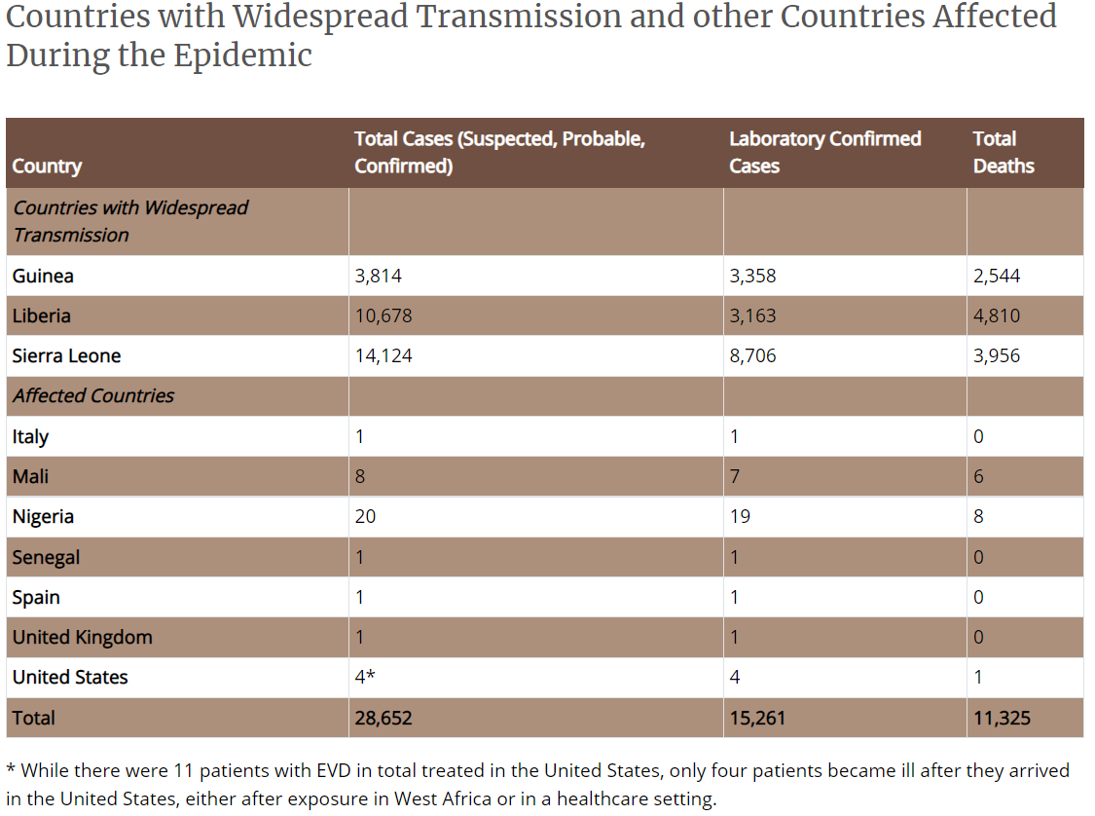

Slide 31
Ebola- 2022
On April 23, 2022, the Democratic Republic of the Congo declared an outbreak of Ebola. This is the 14th outbreak in the Congo and marks the third in a series of outbreaks since 2018 (1 in 2018, 1 in 2020). Sequencing data indicates that this is a new spillover event from an animal to a person and is not directly linked to previous outbreaks.
The first patient identified in this outbreak sought treatment at several healthcare facilities and was taken to am Ebola Treatment Centre after signs of bleeding began. A positive PCR test confirmed Ebola.

Slide 32
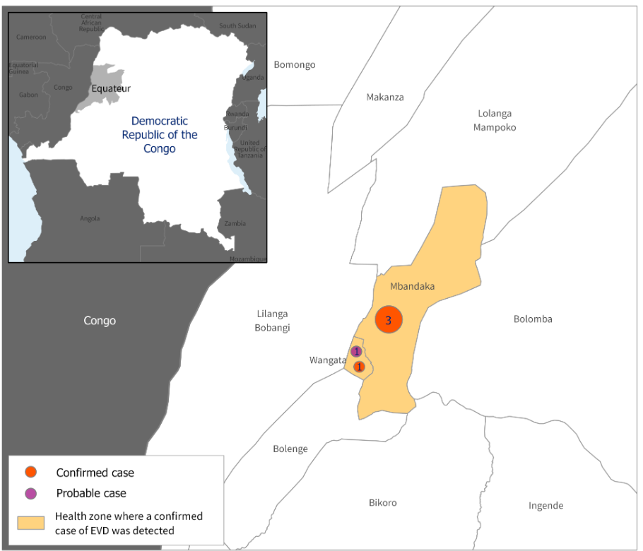

Slide 33
Ebola- 2022
999 people were tested after the initial positive case, with a total of 5 positive cases.
Of those 5 positive cases, none responded to treatment and all died. This outbreak of Ebola had a fatality rate of 100%.
It was eventually identified as Zaire ebolavirus. Mutations are suspected as the reason that no one responded to treatment.

Slide 34
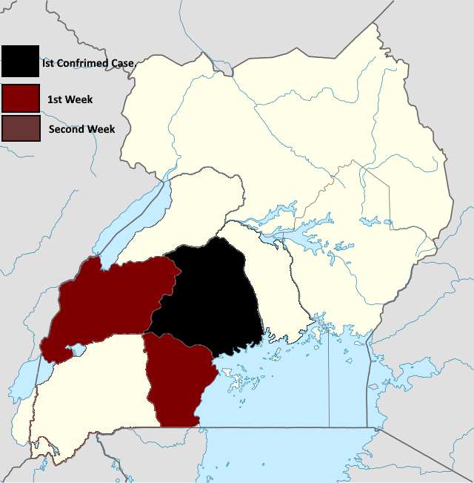
Ebola- 2022
Uganda had a mass outbreak of Ebola in November of 2022. 164 confirmed cases, with 55 people dying. 55% percent of cases were fatal.
This was Sudan ebolavirus

Slide 35
Ebola 2023
On May 8th 2023, the Democratic Republic of Congo reported a positive Ebola case. Testing is still undergoing, but it does not appear to be an outbreak, but instead an isolated case.

